Slide 1
CSE 486/586 Distributed Systems Wrap-up
Steve Ko
Computer Sciences and Engineering
University at Buffalo

Slide 2
Building a Distributed System
“The number of people who know how to build really solid distributed systems…is about ten”
Scott Shenker, Professor at UC Berkeley
Are you confident now?
What were the most interesting topic to you?

Slide 3
Things We Discussed (Midterm)
Networking basics (feat. the Internet)
Failure detection
Time synchronization
Logical time & global states
P2P & DHT
Reliable multicast
Consensus basics
Mutual exclusion & leader election
RPC

Slide 4
Things We Discussed
Transactions & concurrency control
Replication
Gossiping
Distributed file systems
Distributed shared memory
Paxos
BFT
Security

Slide 5
The Way I See It
We’ve learned some of the building blocks & fundamental results…
Networking basics, failure detection, logical time, reliable multicast, mutual exclusion, leader election, transactions, concurrency control, replication, gossiping, Paxos, BFT, …
…and how real systems get built using those…
P2P, DHT, Dynamo, FAWN, Chubby, …
…and also got some experience in building/using the fundamental building blocks…
Ordered multicast for messaging, a DHT, and a replicated key-value storage

Slide 6
Distributed Systems 10 Questions
Course goal: answering 10 questions on distributed systems
At the end of the semester, if you can answer only 10 questions about distributed systems, you’ll probably get an A.
Easy enough!
What are those questions?
Organized in 6 themes
1~2 questions in each theme
A few (or several) lectures to answer each question

Slide 7
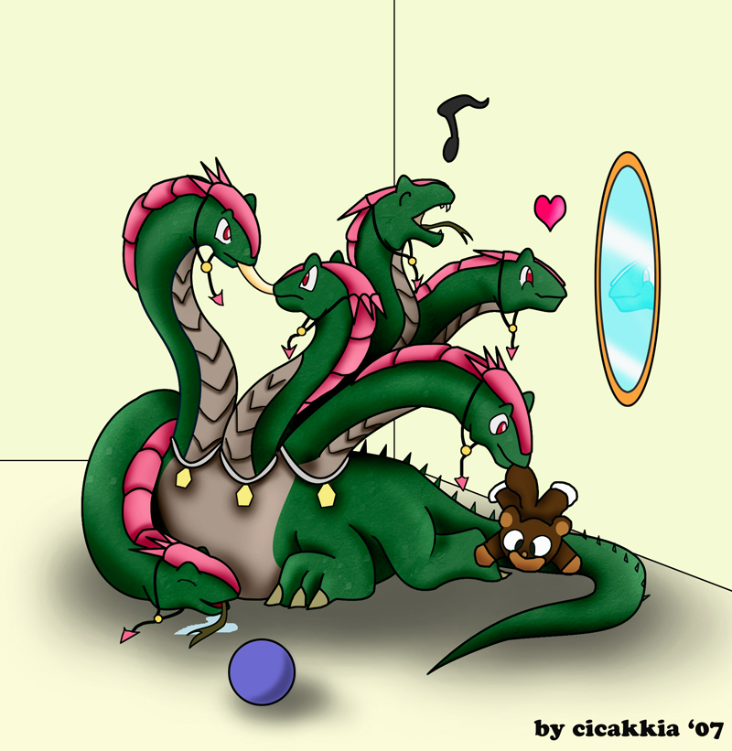
Theme 1: Hint
What’s up?
Hey!

Slide 8
Theme 1: Communications
Q1: how do you talk to another machine?
A: Networking basics
Know how to use socket now?
Q2: how do you talk to multiple machines at once?
A: Multicast
What is “reliable multicast”?
What orderings are there for ordered multicast?
Q3: can you call a function/method/procedure running in another machine?
A: RPC
What is a stub compiler (generator)?

Slide 9
Theme 2: Hint
I thought I was doing it…
I’m shaking my tail.
What? I’m doing it too!

Slide 10
Theme 2: Concurrency
Q4: how do you control access to shared resources?
A: Distributed mutual exclusion, leader election, etc.
Ring election? Modified ring election? Bully algorithm?

Slide 11
Theme 3: Hint
I want to shake my tail.
OK
No, I don’t want to.
No way!

Slide 12
Theme 3: Consensus
Q5: how do multiple machines reach an agreement?
A: it’s impossible! (the FLT result), but algorithms do exist that get around the impossibility (Paxos, BFT, etc.)
What are the phases for Paxos?

Slide 13
Theme 4: Hint
Who has a brain?
I do.
I don’t.

Slide 14
Theme 4: Storage Management
Q6: how do you locate where things are and access them?
A: DHT, distributed file systems, etc.
Consistent hashing?

Slide 15
Theme 5: Hint
I have a feeling that something went wrong…
zzz…

Slide 16
Theme 5: Non-Byzantine Failures
Q7: how do you know if a machine has failed?
A: Failure detection
What is the fundamental limit of a failure detector?
Q8: how do you program your system to operate continually even under failures?
A: Replication, gossiping
Linearizability? Sequential consistency? One-copy seriarizability?

Slide 17

Theme 6: Hint
We’re under attack!

Slide 18
Theme 6: Byzantine Failures
Q9: how do you deal with attackers?
A: Security
What is onion routing?
Q10: what if some machines malfunction?
A: Byzantine fault tolerance
To tolerate f faulty nodes, how many nodes do we need in total?

Slide 19
Android…
Want to register as an Android developer?
Developer Registration
You must register to be able to distribute your products through Google Play. There is a one time $25 registration fee. We charge this fee to encourage higher quality products on Google Play (e.g. less spammy products).
Selling apps
If you're interested in selling priced applications, you'll need to be registered as a Google Checkout Merchant as well. To do this from Google Play publisher site.

Slide 20
CSE 486/586 Administrivia
Project 3 deadline tonight @ 11:59PM
Final
5/7 (Monday), 3:30PM - 6:30PM
Norton 112
Office hours this week
Usual time + usual class time
Today: 4pm – 5pm, WF: 3pm – 5pm
Project scores this week!

Slide 21
Acknowledgements
These slides contain material developed and copyrighted by Indranil Gupta (UIUC).

